Slide 1
The Best place for a Brazilian restaurant in Toronto
Wesley Silva

Slide 2
Analyzing Toronto neighborhoods to find the best place for a Brazilian restaurant
70% of restaurants close after six months, so we want a good place to open the restaurant
A good place instead for:
A well located neighborhood
Potential consumers
Number of competitors in the neighborhood should be take in consideration

Slide 3
Data acquisition and cleaning
Canada postal code list scraped from Wikipedia
Foursquare API
The Canada postal code list will be merged with latitude and longitude returned
by the geopy library and them loaded to a python dataframe
Unusual columns will be dropped
Any borough that not contains the word Toronto will be dropped
As the limitation in using the Foursquare free account we will focus on East Toronto borough
and its 5 neighborhood

Slide 4
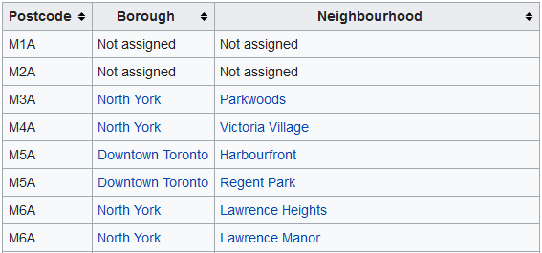
Data acquisition and cleaning
Wikipedia postal code list:

Slide 5
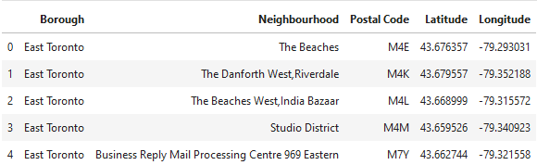
Data acquisition and cleaning
Merged list using geopy library and python dataframe:

Slide 6
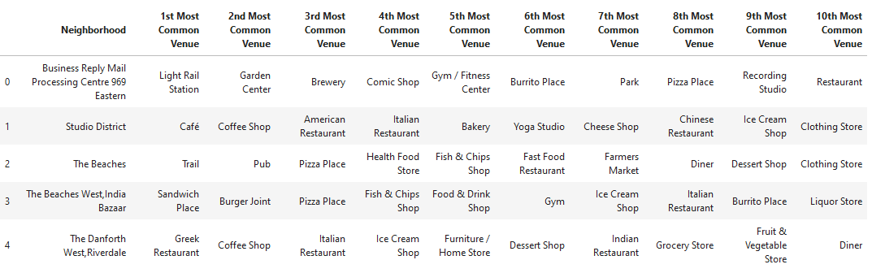
Data acquisition and cleaning
Refined dataframe using the foursquare API to grab the 10 most common venues in East Toronto

Slide 7
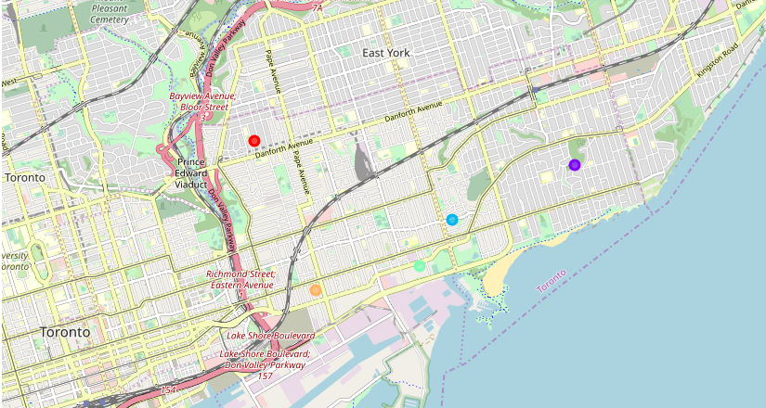
K-means clustering process
Generated map with 5 clusters

Slide 8
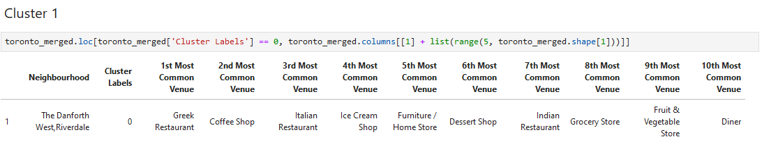
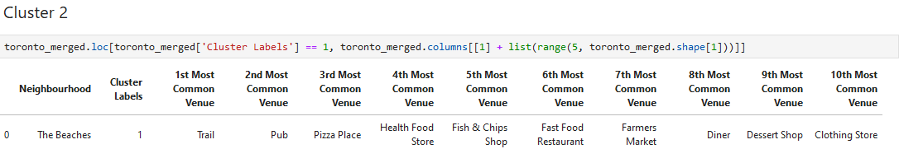
K-means clustering process
Analyzes of individual clusters:
The Danforth West, Riverdale Cluster
The Beaches Cluster

Slide 9
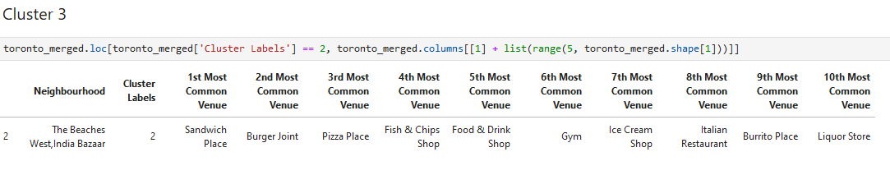
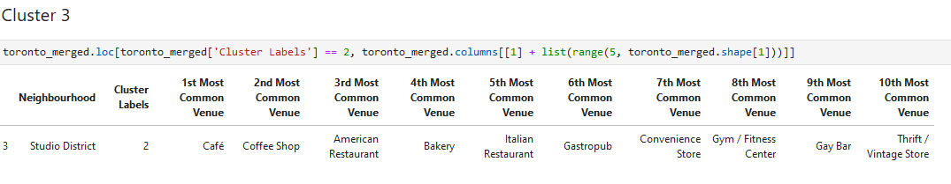
K-means clustering process
Analyzes of individual clusters:
The Beaches West, India Bazaar Cluster
Studio District Cluster

Slide 10
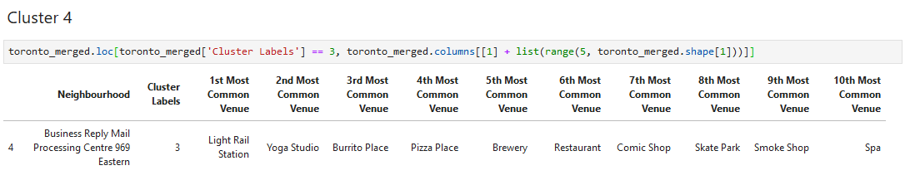
K-means clustering process
Analyzes of individual clusters:
Business Reply Mail Processing Centre 969 Eastern

Slide 11
Conclusion and future directions
Build a usual model to discover potential good places to open a restaurant
The model has room for improvement
Capture more neighborhoods and other kind of data such as competitors price, menu, etc…

